Slide 1
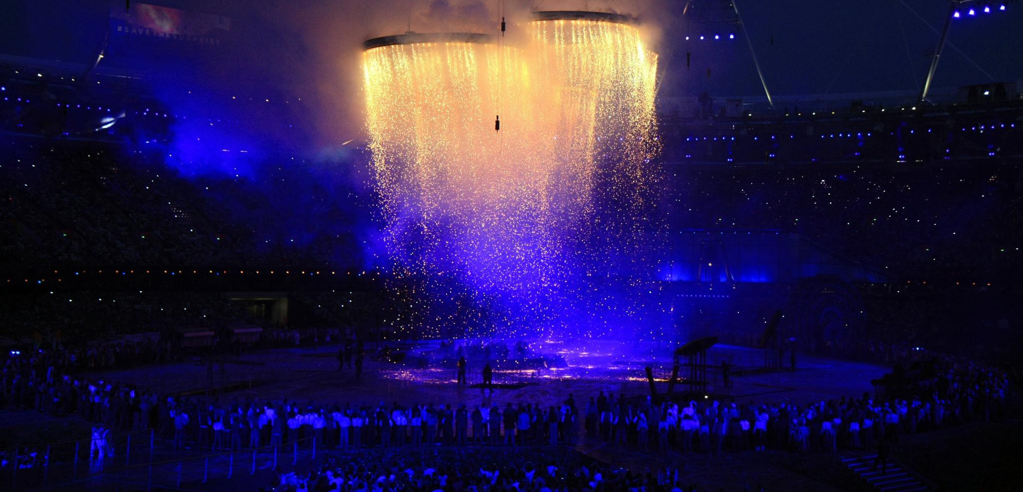

TOKYO OLYMPIC DATA ANALYSIS

Slide 2


Team Members
Sri Charana Indaram
Data Engineer
Amarnath Reddy Pamireddygari
Data Scientist
Harika Suravarapu
App Development
Venkata Naga Sandeep Gude
Data Modelling

Slide 3

Introduction
The Olympic Games represent a pinnacle of global sporting excellence and cultural significance, attracting athletes, coaches, and spectators from around the world. Analyzing Olympic data provides valuable insights into athletes' performances, trends over time, and countries' sporting achievements. In this study, we leverage the capabilities of Azure cloud computing to conduct comprehensive analysis of Olympic data spanning multiple domains.

Slide 4

Abstract
The project aims to demonstrate the capabilities of Azure Cloud for performing end-to-end data engineering tasks, from data extraction to visualization of insights, using a real-world dataset such as Olympic data.

Slide 5

Problem Statement
The challenge is to effectively utilize the extensive and interconnected Olympic dataset, comprising multiple tables like Athletes, Coaches, Entries Gender, Medals, and Teams, for actionable insights. Traditional approaches face hurdles in data integration, scalability, and resource constraints, hindering stakeholders' ability to optimize athlete performance, resource allocation, and strategic initiatives. Therefore, the problem statement revolves around developing a robust data analysis framework using Azure cloud computing to efficiently process Olympic data, uncover meaningful patterns, and empower stakeholders with informed decision-making capabilities.

Slide 6
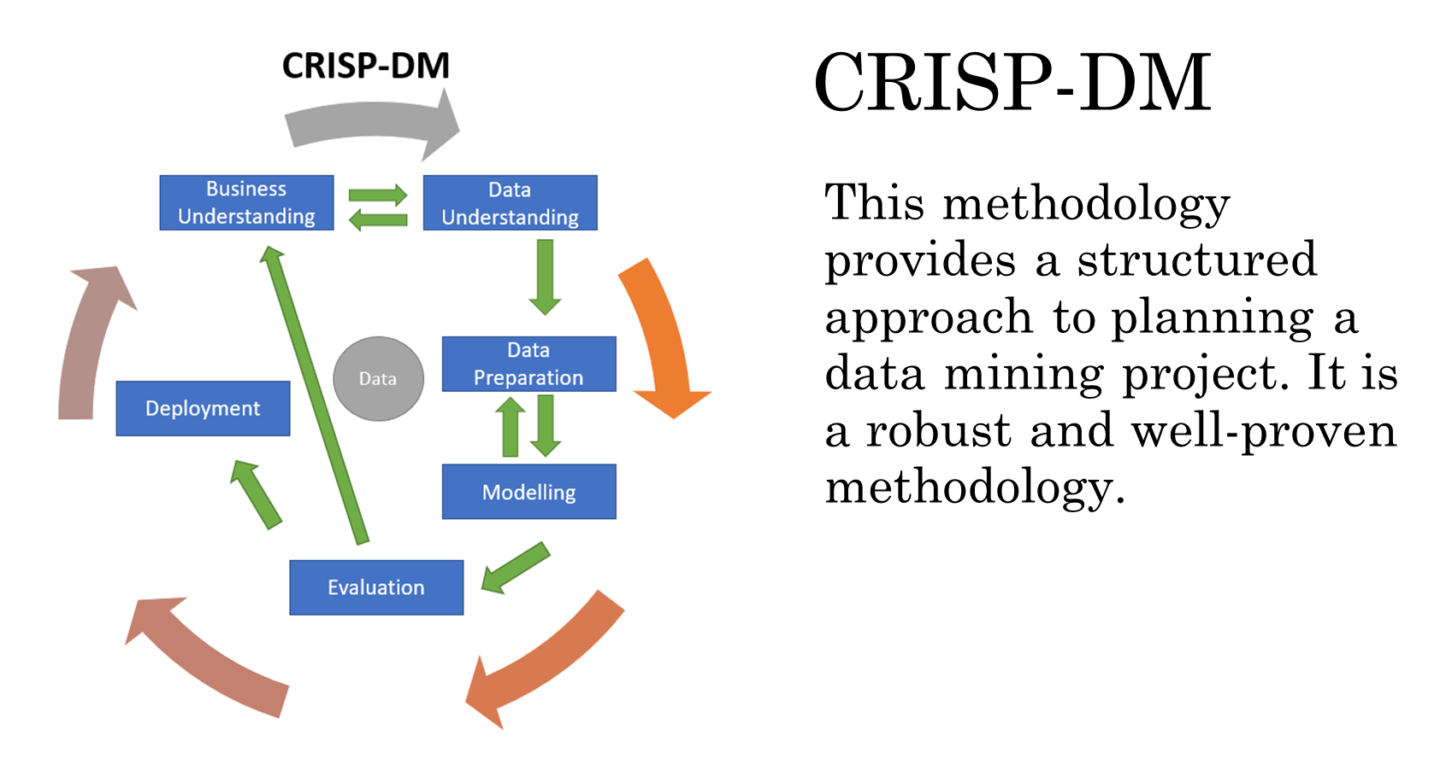

Slide 7

Business Understanding
The project aims to demonstrate the value of data analytics in the sports industry and showcase how organizations can leverage Azure services to unlock the transformative potential of Olympic data for strategic decision-making, performance management, and competitive advantage.
This Photo by Unknown author is licensed under CC BY-SA.

Slide 8

Data Understanding
The dataset contains information on 11,000 athletes participating in 47 disciplines and representing 743 teams in the Tokyo Olympics 2021.
The files are available in CSV format for easier data processing, covering categories such as athletes, coaches, entries, medals, and teams.
Dataset link

Slide 9
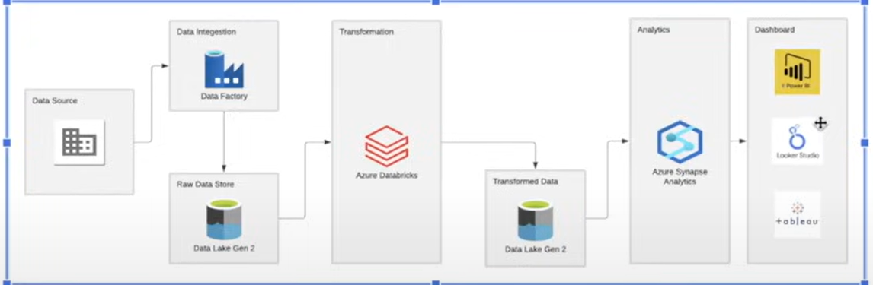

Data Pipeline:

Slide 10

Data Extraction with Azure Data Factory:
Utilized Azure Data Factory to extract data from the API and load it onto Azure Data Lake Storage. Configure a pipeline to automate the data ingestion process, ensuring timely and efficient extraction of raw data.
Data Transformation with Azure Databricks:
Used Azure Databricks to perform data transformation tasks, including data cleaning, aggregation, and enrichment, using Spark code. Write Spark code to process the raw data and transform it into a structured format suitable for analysis.

Slide 11

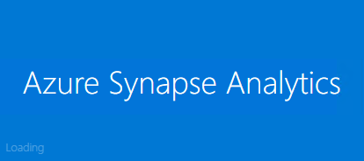
Load Transformed Data to Data Lake Storage:
After transforming the data, load it back to a separate storage location within the Data Lake Storage account, referred to as the transformed data Lake storage. This ensures that the processed data is readily available for subsequent analysis.
Data Analysis with Azure Synapse Analytics:
Utilize Azure Synapse Analytics to run SQL queries on top of the transformed data stored in the Data Lake Storage. We write SQL queries to extract insights, perform aggregations, and generate visualizations to uncover patterns and trends within the Olympic dataset.

Slide 12
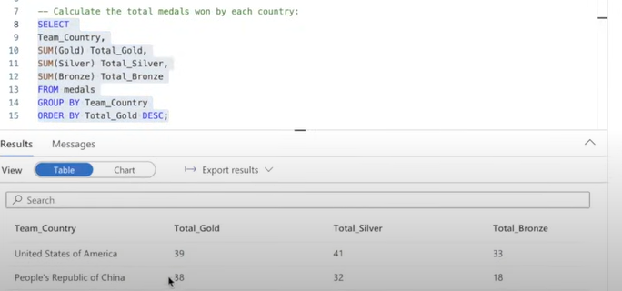
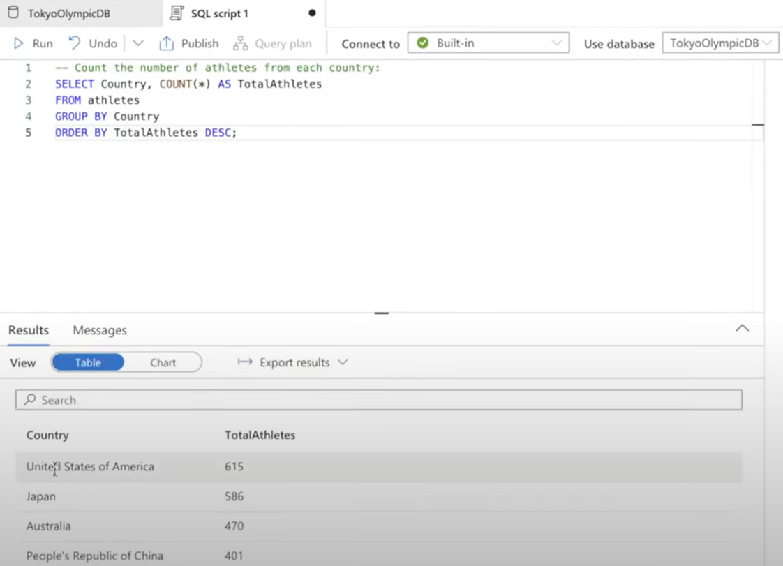
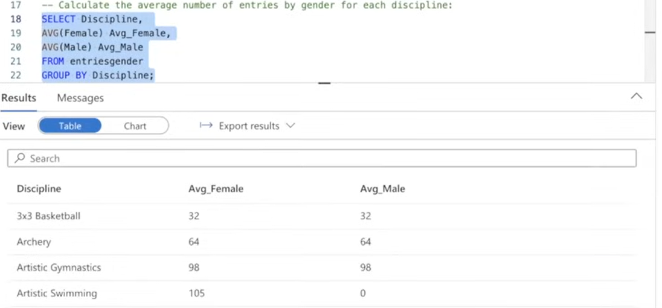

Slide 13
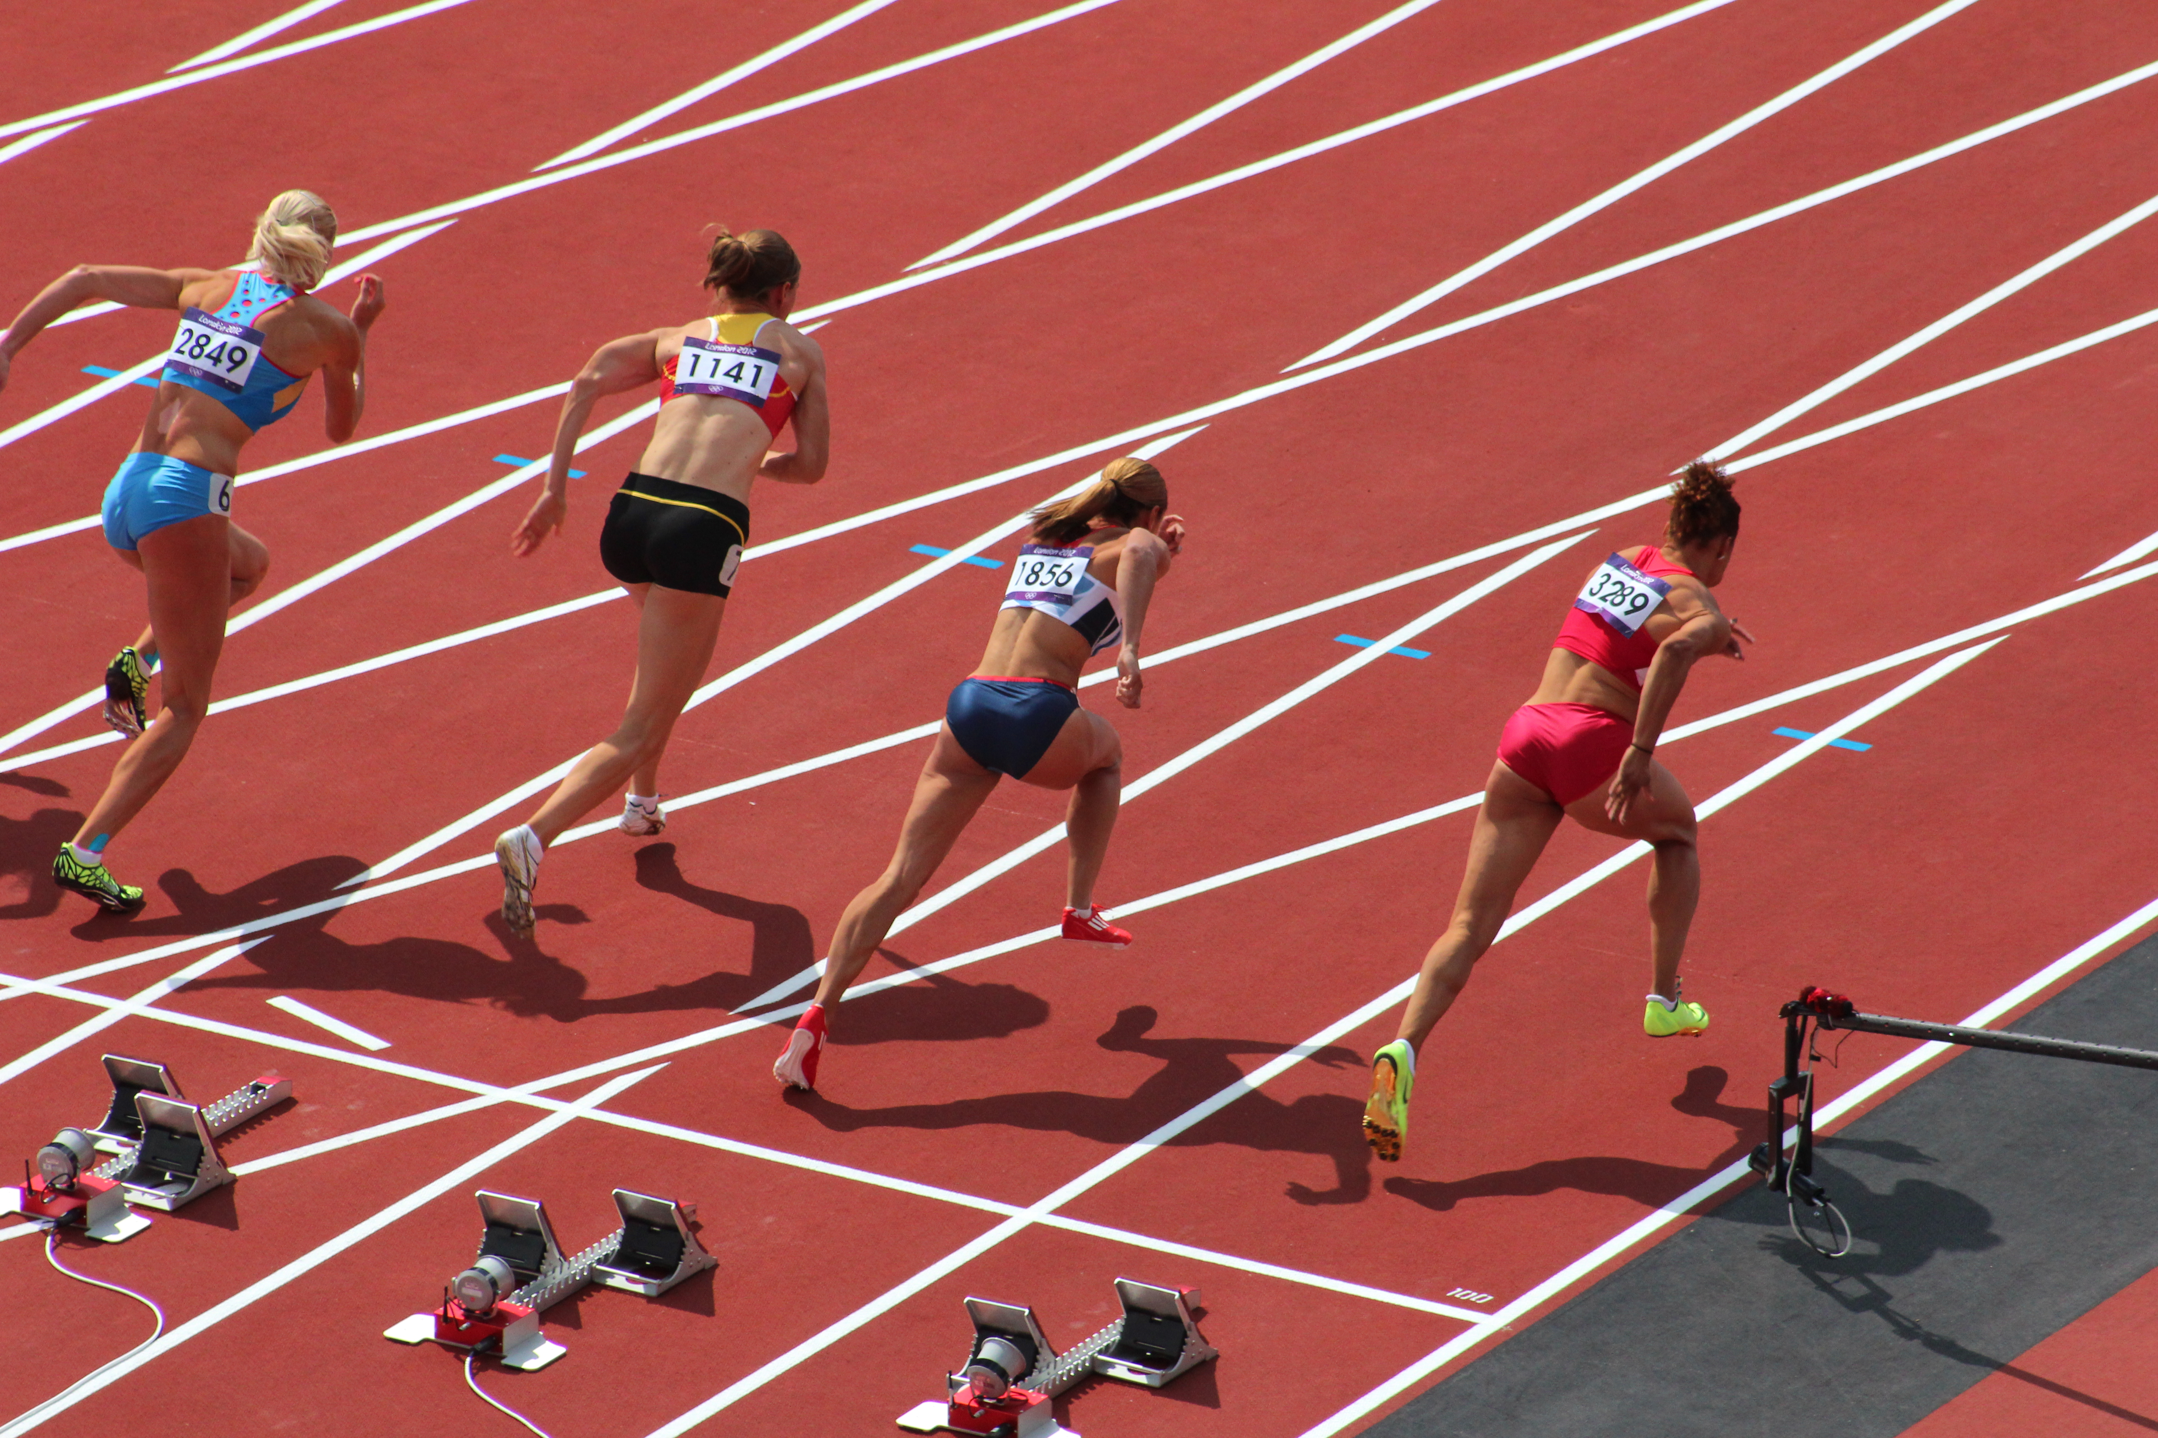
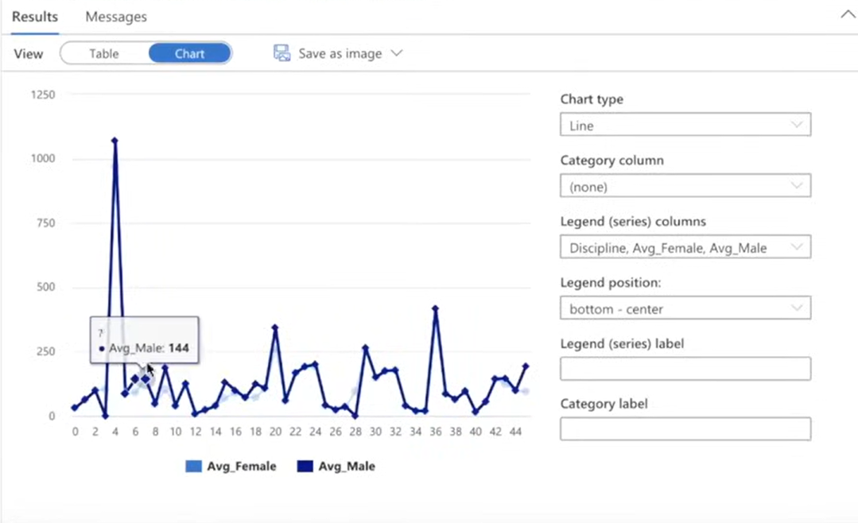

Slide 14
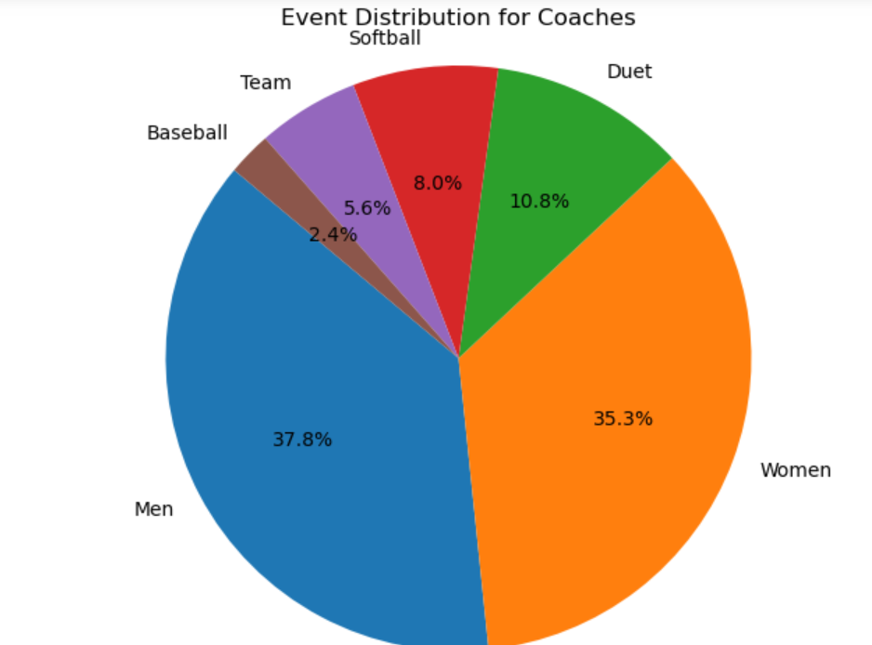
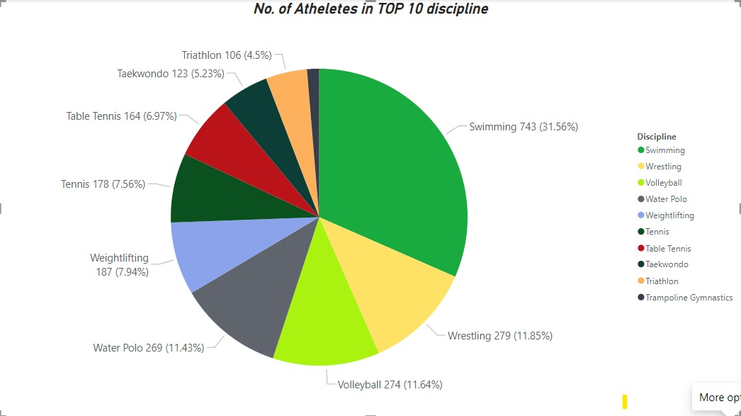
5. Visualization of Insights:
Use visualization tools available in Azure Synapse Analytics or external tools like PowerBI to create visualizations and dashboards based on the analytical findings. Visualizations can include charts, graphs, and interactive dashboards to present insights in a clear and understandable manner.

Slide 15
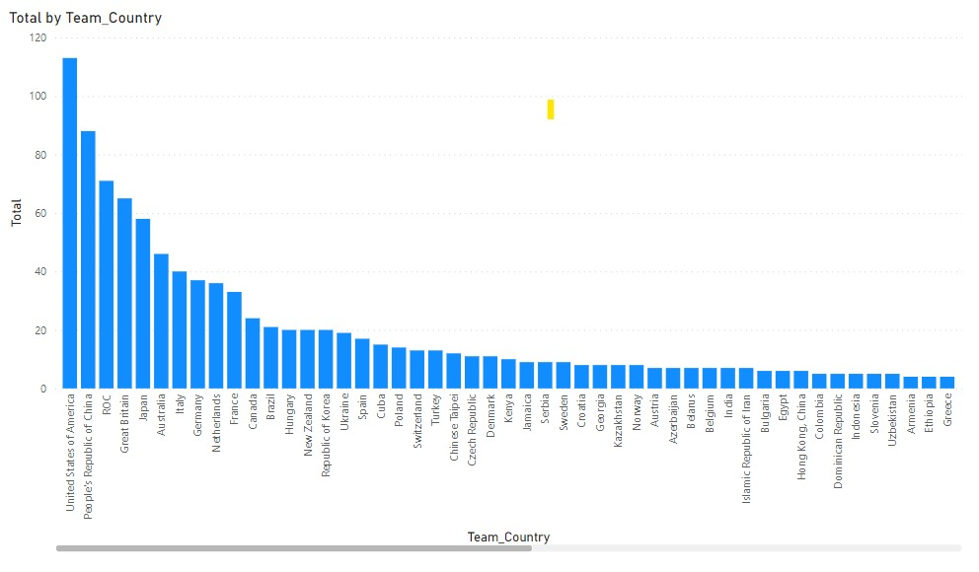
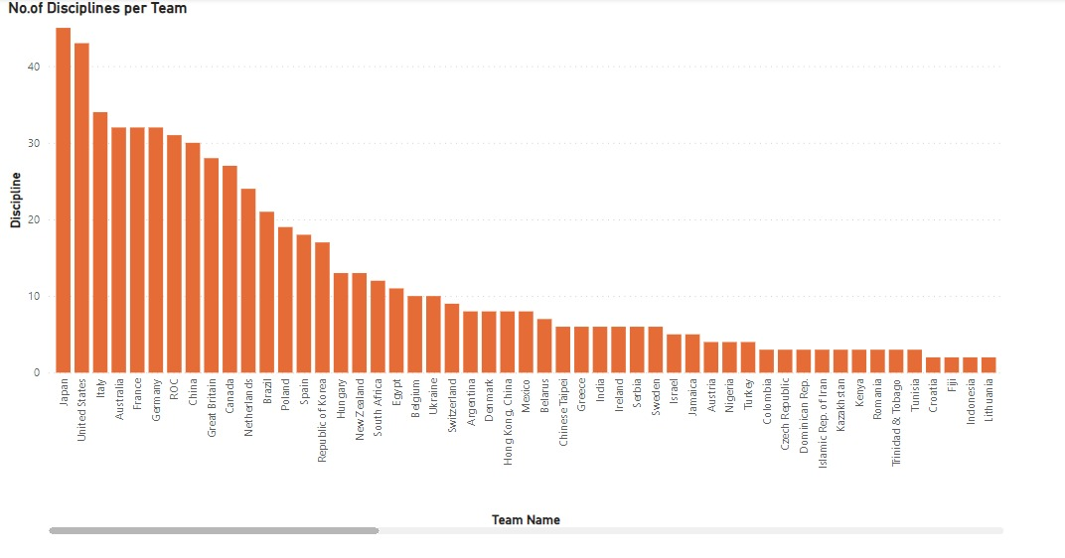

Slide 16

Conclusion
To sum up, our study has shown how valuable it is to use Azure cloud computing to analyse Olympic data in-depth. Our understanding of athlete performances, time patterns, and national athletic accomplishments has improved as a result of our use of Azure services for data extraction, transformation, and visualisation. These revelations might help the sports sector make more strategic decisions and maximise athlete performance. In the future, further research and development into data analytics methods will be necessary to uncover new information and spur creativity in the field of sports administration and performance enhancement.

Slide 17

GitHub Link
https://github.com/The-Team-12/Tokyo-Olympics-Data-Analysis

Slide 18

THANK YOU

